Slide 1
Java Operators

Slide 2
Java Operators
Operators are used to perform operations on variables and values.
Java divides the operators into the following groups:
Arithmetic operators
Assignment operators
Comparison operators
Logical operators
Bitwise operators

Slide 3
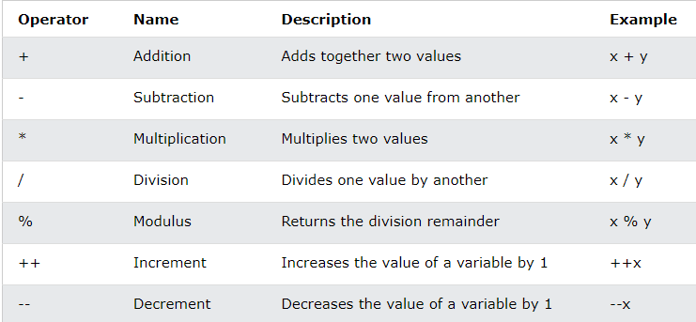
Arithmetic Operators
Arithmetic operators are used to perform common mathematical operations.

Slide 4
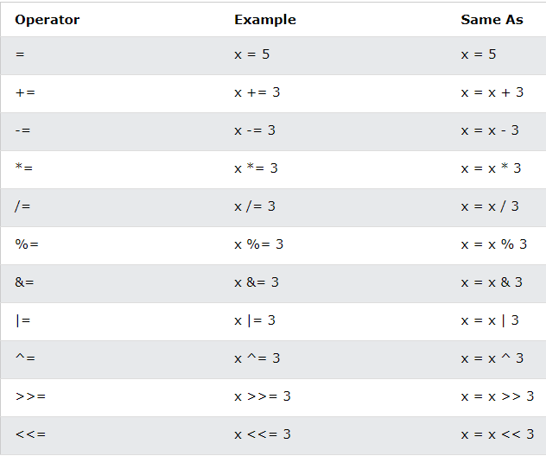
Java Assignment Operators
Assignment operators are used to assign values to variables.

Slide 5
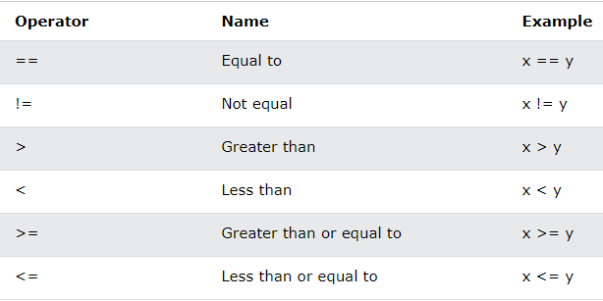
Java Comparison Operators
Comparison operators are used to compare two values:

Slide 6
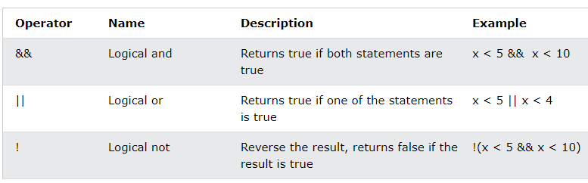
Java Logical Operators
Logical operators are used to determine the logic between variables or values:

